Slide 1
CSE 216
Project Presentation and ERD Submission
Presented By :
Tousif Tanjim Anan, 1705053
Anwarul Karim, 1705055

Slide 2
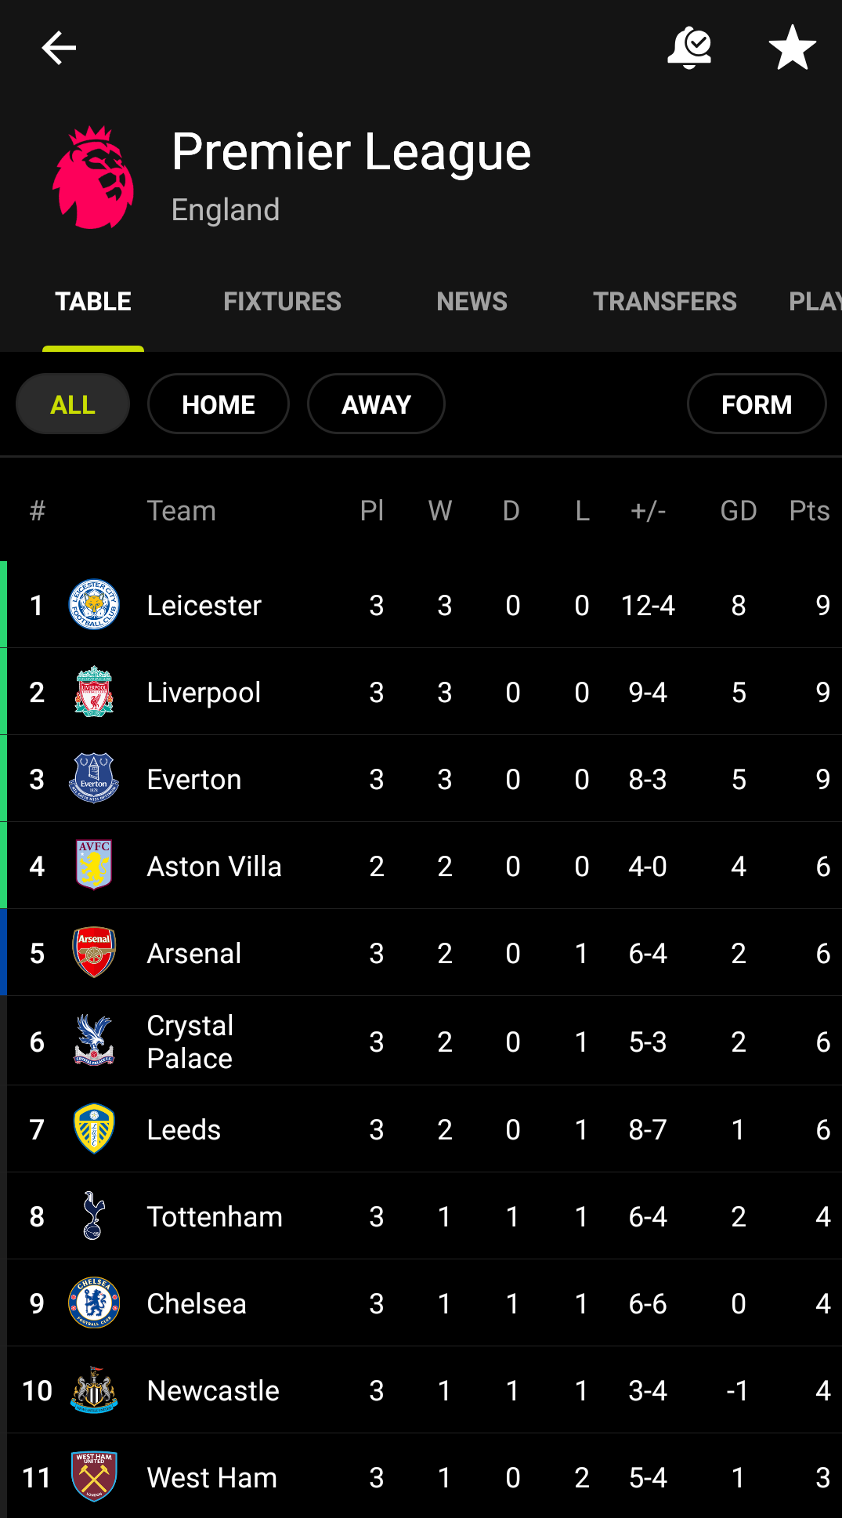
Project : FotMob
FotMob is a famous app to check football scores,get info about clubs, players and teams. It covers a vast number of leagues.
For the sake of convenience, we will be working on Premier League only.

Slide 3
What Information Will Be Included?
We will try to display information about –
Teams
Players
Matches
Stadium
Coaches
Referees
Scores

Slide 4
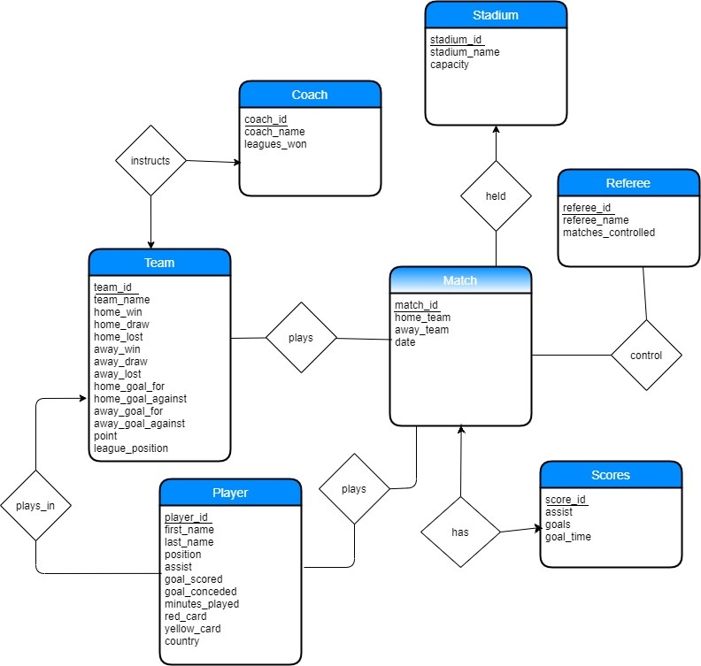
ERD Preview

Slide 5
Thank You!

